Slide 1


FB Messenger ChatBot

Slide 2
What is a bot?
Bot is a software that automates things that we do.

Slide 3
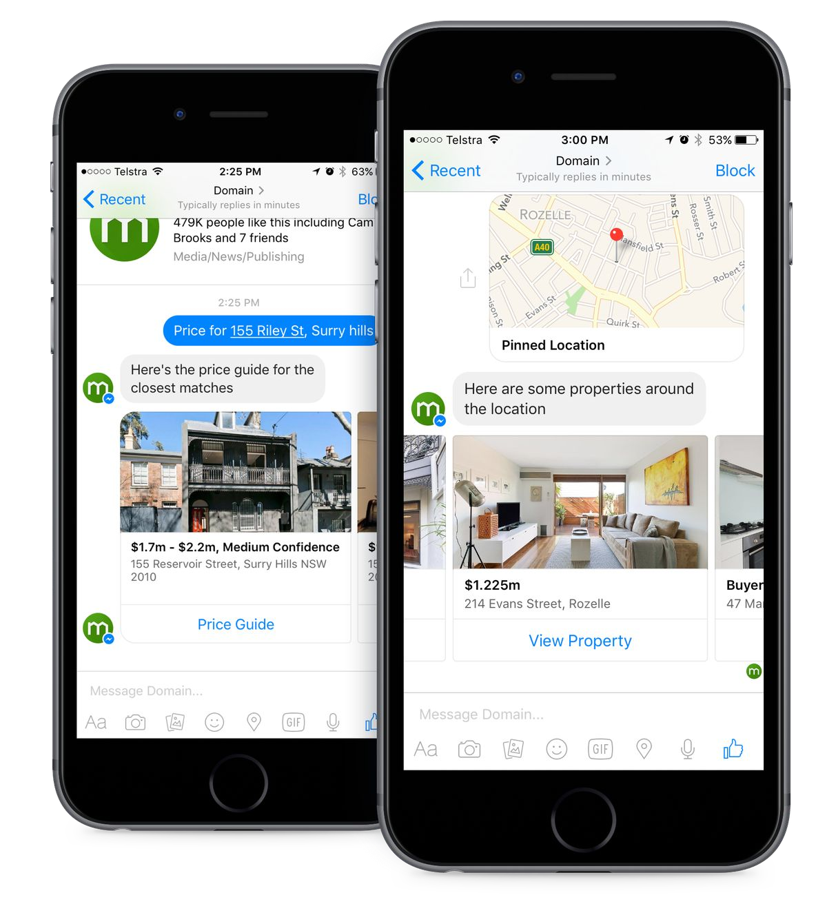

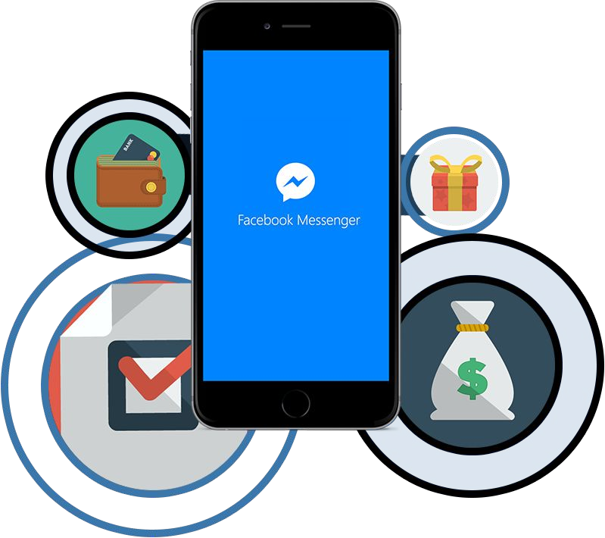
The process of building a FB Messenger Chat Bot
Part 1: Putting Bot on in the Cloud
Part 2: Connecting your Bot with FB Messenger
Part 3: Use Api.ai with Your Bot

Slide 4
No Server

Slide 5
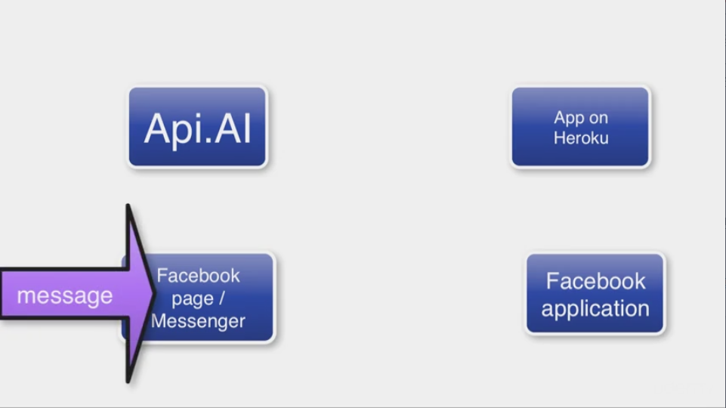

Slide 6
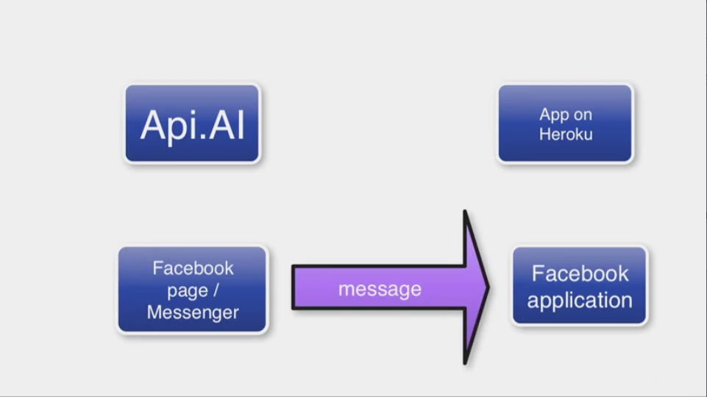

Slide 7
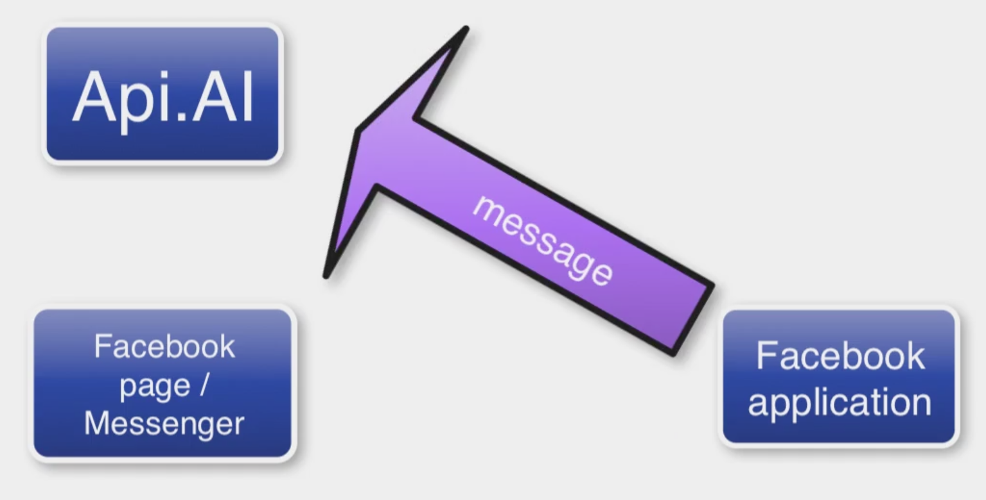

Slide 8
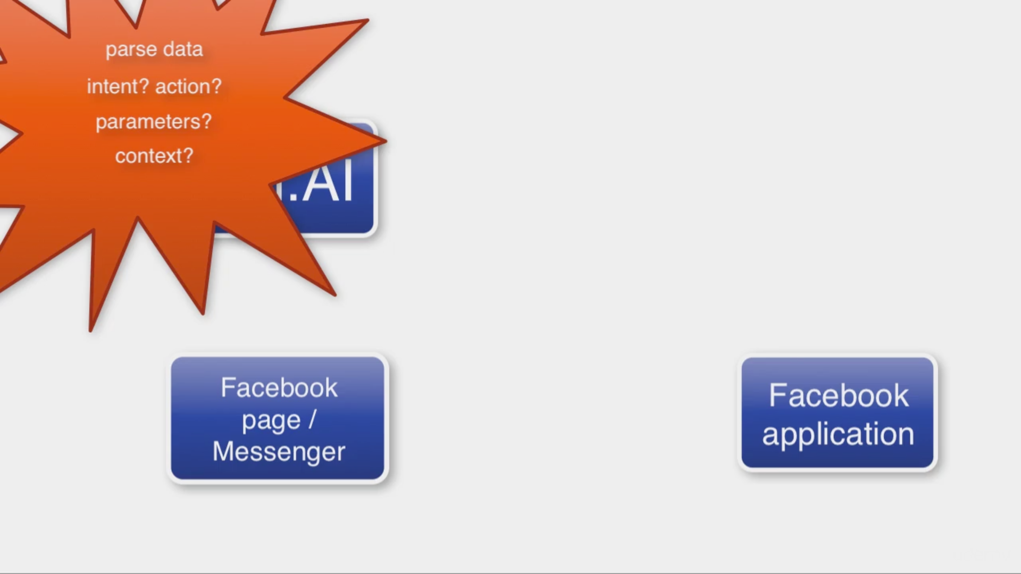

Slide 9
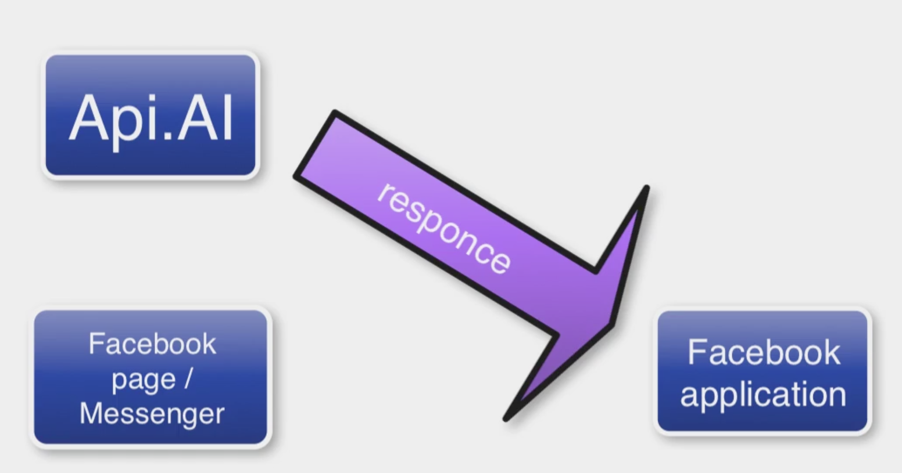

Slide 10
Have Server

Slide 11
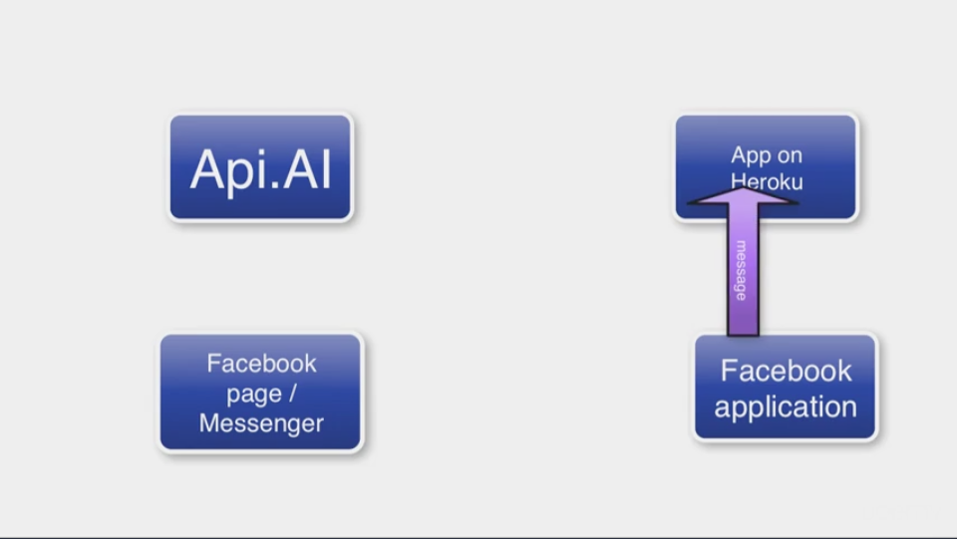

Slide 12
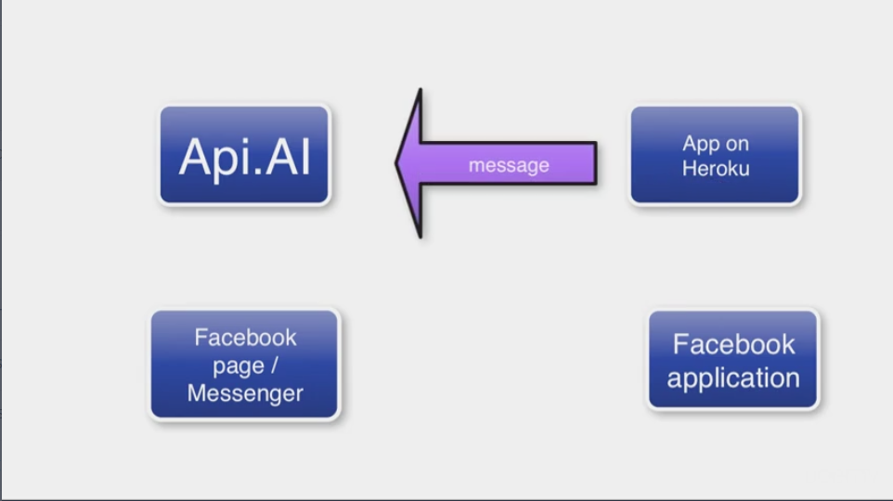

Slide 13
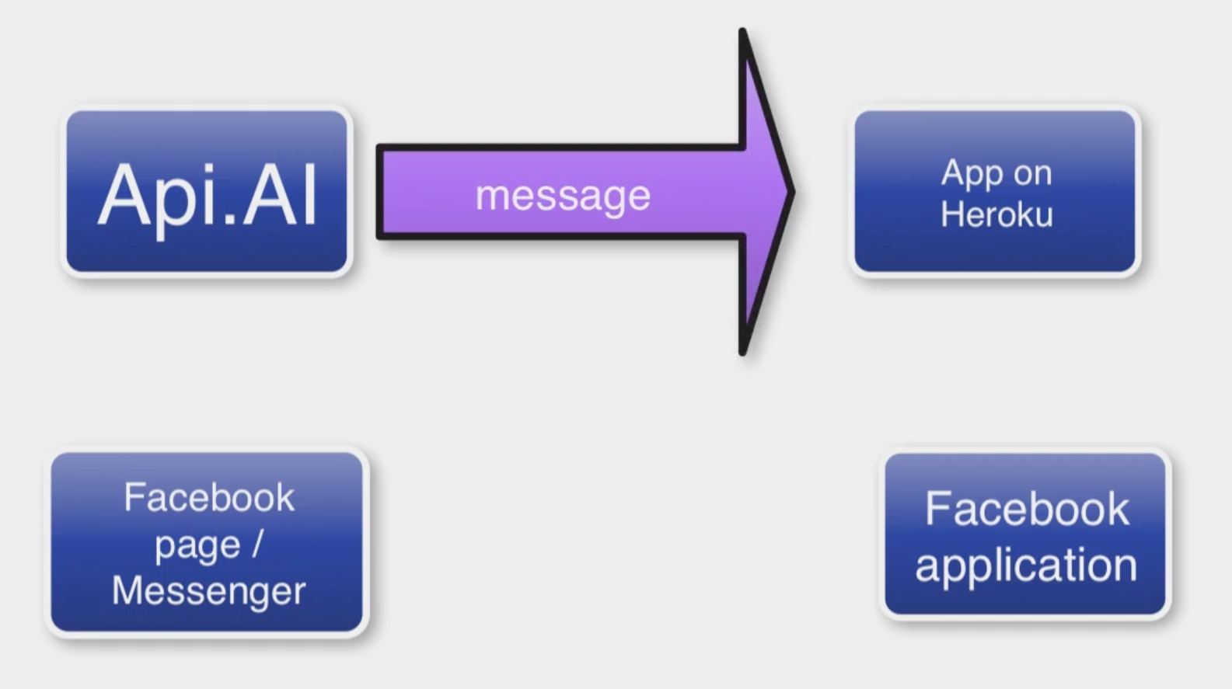

Slide 14
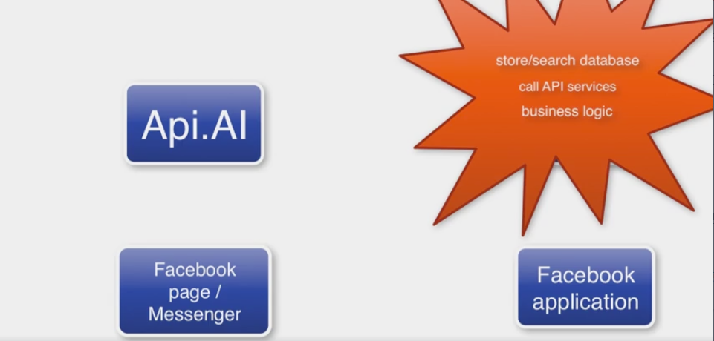

Slide 15
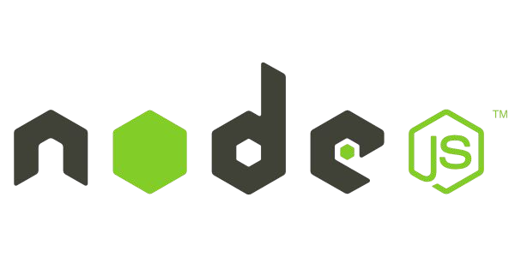

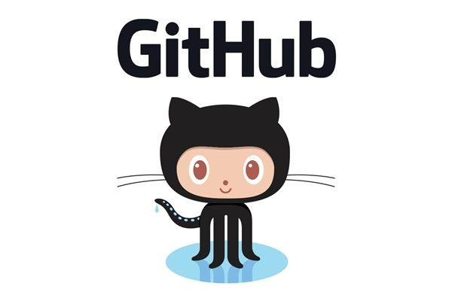
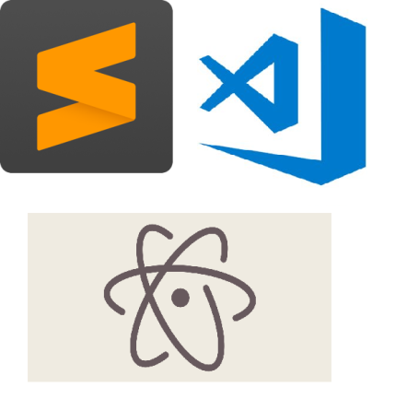
What you’ll Need

Slide 16
Part 1: Putting Your Bot on the Cloud

Slide 17
Node.js
We will be using JavaScript and Node. js for this project.
Download Node.js: https:
//nodejs.org

Slide 18
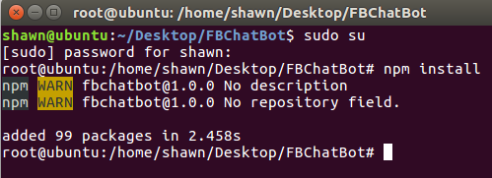

Setting up NPM & Dependencies
1. Open Up Terminal / Command Line
3. In Command Line:
Make Sure you have latest npm: sudo npm install npm --global
To Initialize npm in Project:
npm init
Install Node Dependency for sending and requesting messages:
2. Create Project Folder
npm install express request body-parser --save

Slide 19
GitHub Repository
$git init

Slide 20
1. Heroku Hosting
Heroku offers free accounts and is a great place to host your chat bot.
Sign up at: https://www.heroku. com
2. Heroku Toolbelt
Download Heroku toolbelt to be able to launch, stop and monitor instances.
Download: https://toolbelt. heroku.com

Slide 21
Install Heroku
Debian/Ubuntu:
In Command Line:
Install:
wget -qO- https://cli-assets.heroku.com/install-ubuntu.sh | sh
Login:
heroku login

Slide 22
Using Bot Index.js File
Index.js
This is the main working file for your app. If you don’t have an index.js file or code you can do one of the following:
Use our Bot Code
Create own Bot App
Get Sample Bot Code from online repository

Slide 23
Deploy Code to Heroku
Procfile
Procfile lets Heroku know what files to run. Creating a Procfile takes one line of code:
In Terminal type:
git status
git add .
git commit - -message ‘your message’
heroku create [name]
git push heroku master
web: node index.js
Save it as ‘Procfile’ in your project.
Notes:
補充
以價錢來說，雖然 Heroku 有提供免費使用額度，但因為免費的機器有「30 分鐘沒有人連線的話就會進入休眠」以及「每天至少要休眠 8 小時」的限制，如果是創業初期，可先選擇每個月 7 元方案，待使用者變多、網站流量開始變大之後可再昇級更高等級的設備。

Slide 24
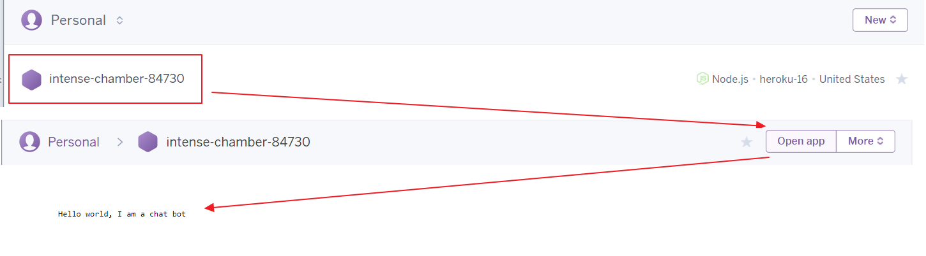
Congrats, Your App is Alive!!!
1. Go to your Heroku Dashboard
2. Select App then Open it

Slide 25
Part 2: Connecting Your Bot with FB

Slide 26
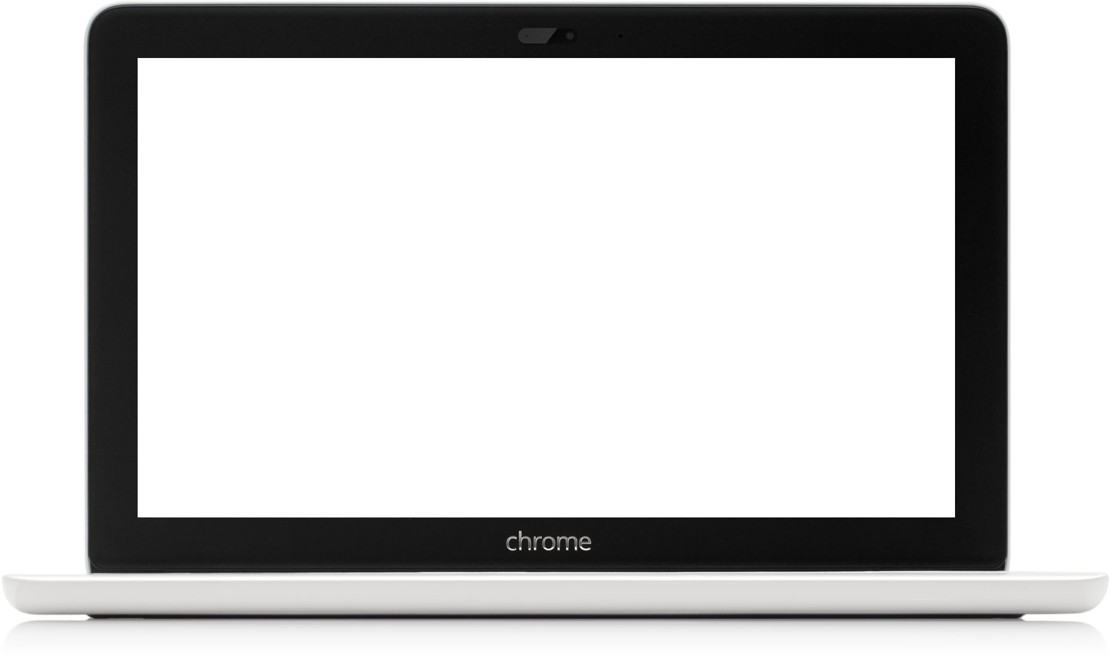
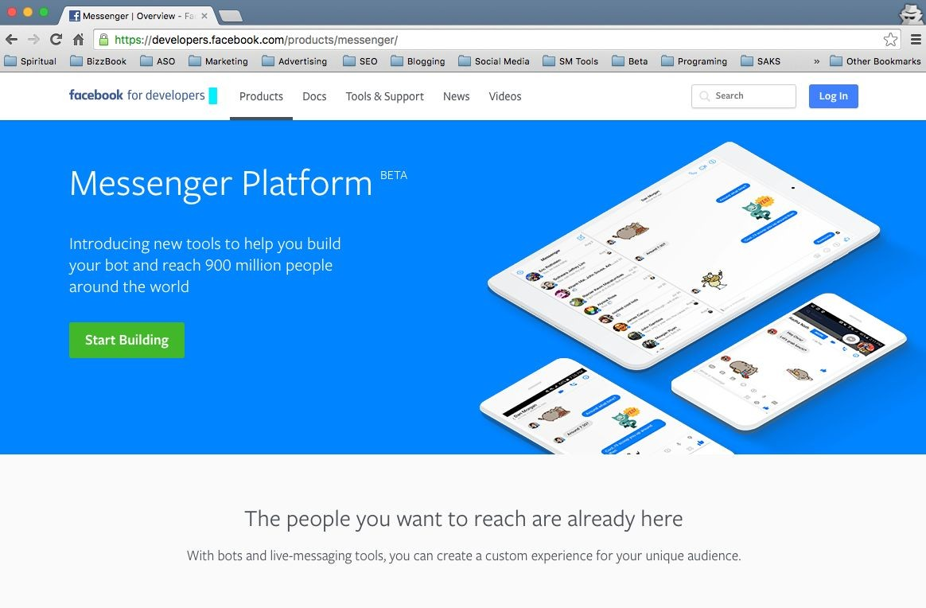
FB Developer
Sign up to Facebook Developer Program
Sign up: https://developers. facebook. com/products/messenger/

Slide 27
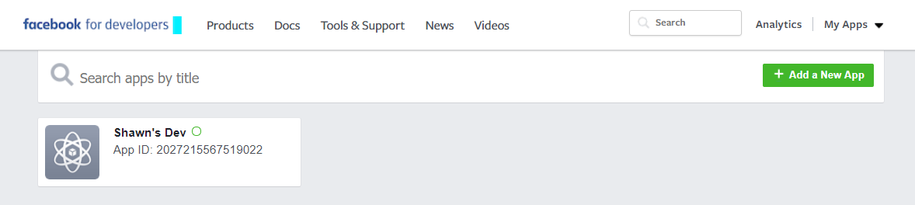
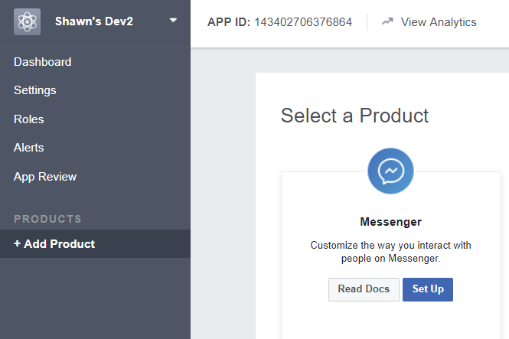
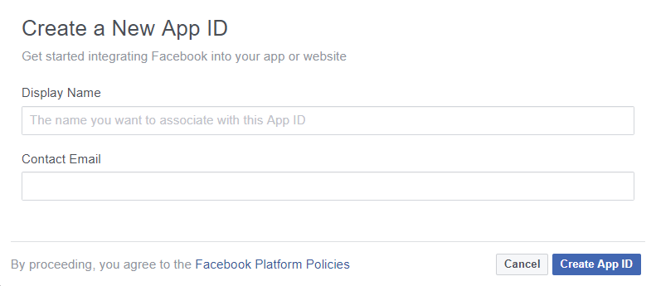

Creating App in FB

Slide 28
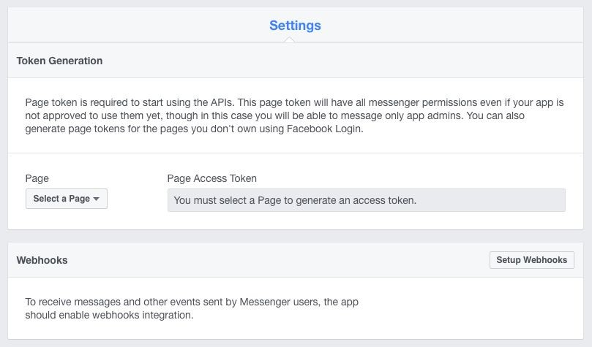
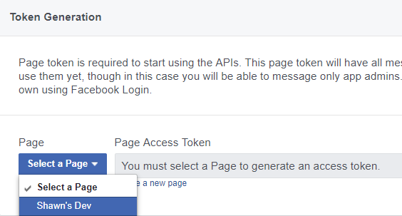
Save Page Token to your index.js file
Select Page

Slide 29
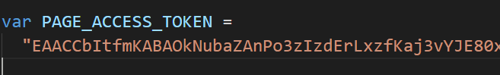
Add token in code

Slide 30
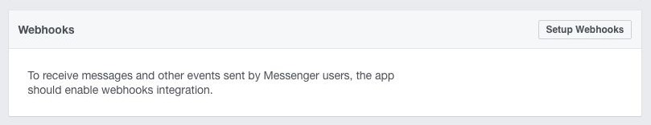
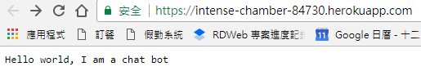
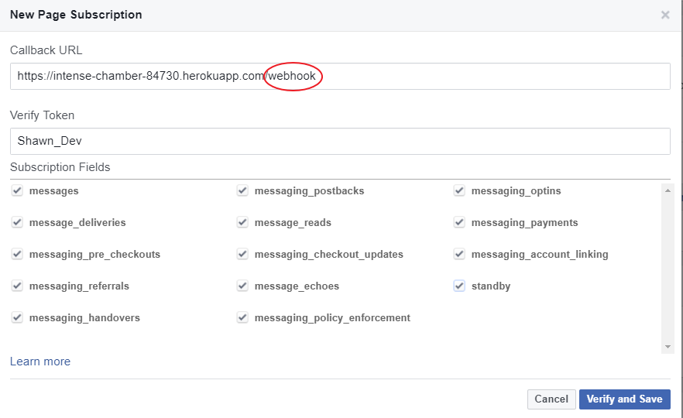
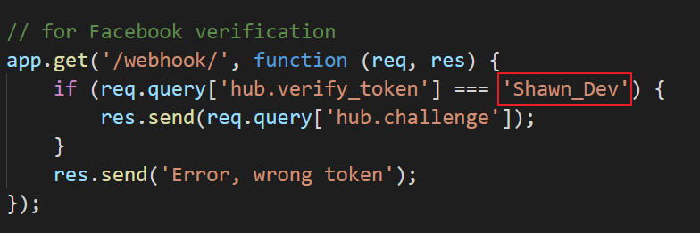
Setting up Webhooks
https://yourdomain.com/webhook/

Slide 31
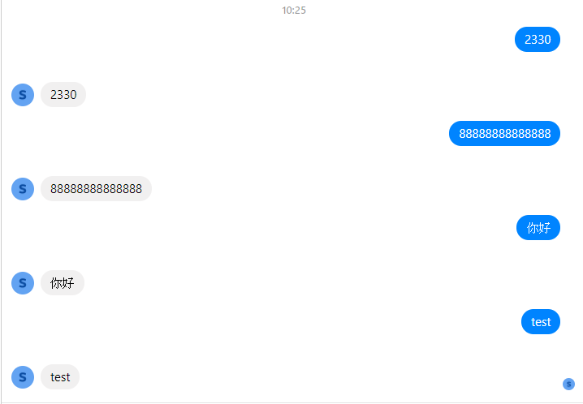
Demo

Slide 32
Part 3 Use Api.ai with Your Bot

Slide 33

Api.ai
API.ai allows developers to integrate your app with the AI system with speech-to-text and natural language processing.
https://dialogflow.com/
$ npm install apiai

Slide 34
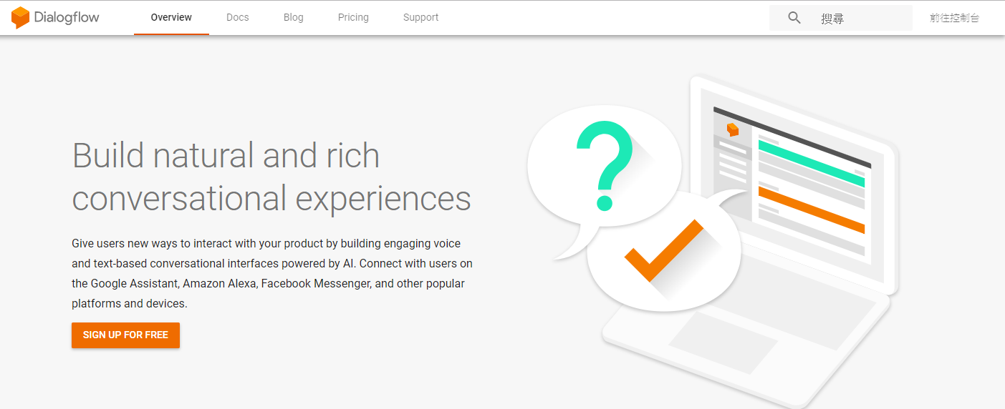
Api ai

Slide 35
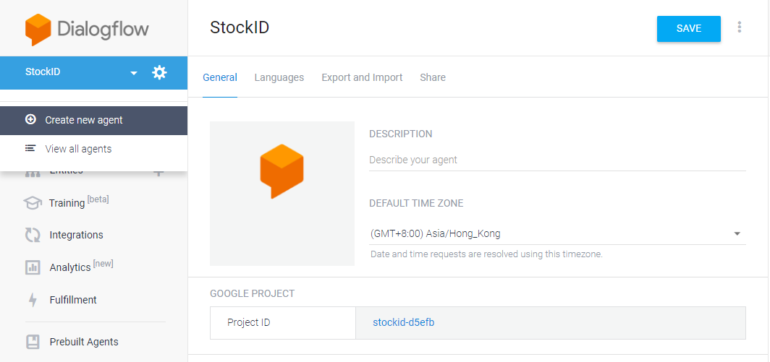
Api ai

Slide 36
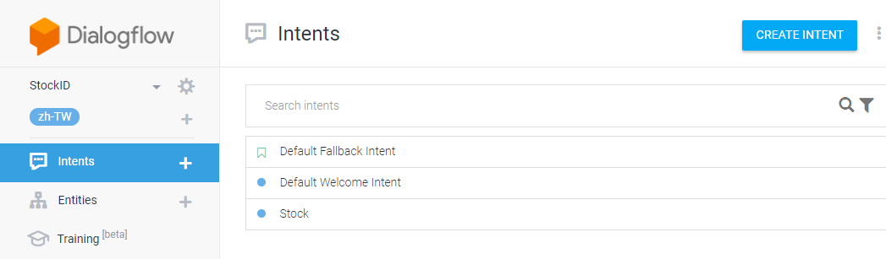
Api ai

Slide 37
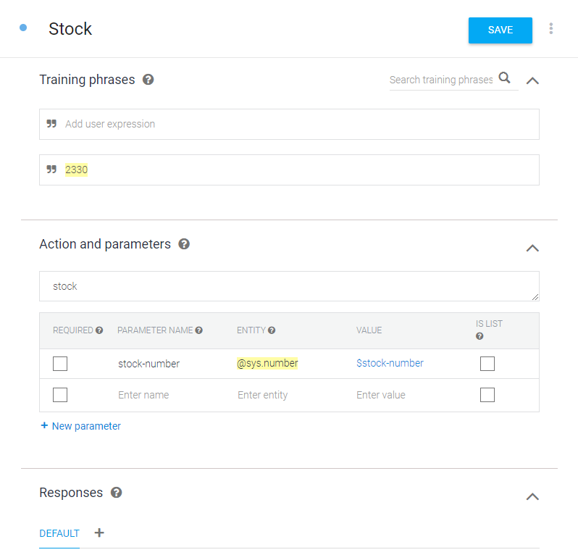
Api ai

Slide 38
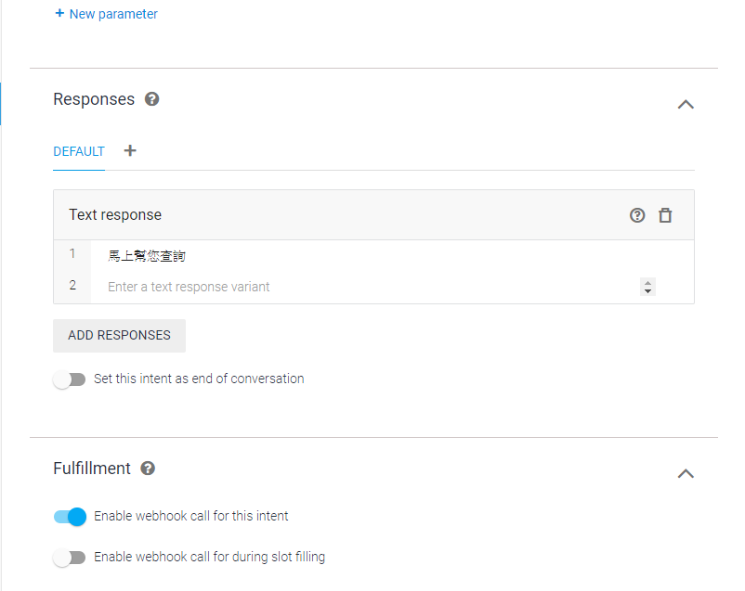
Api ai

Slide 39
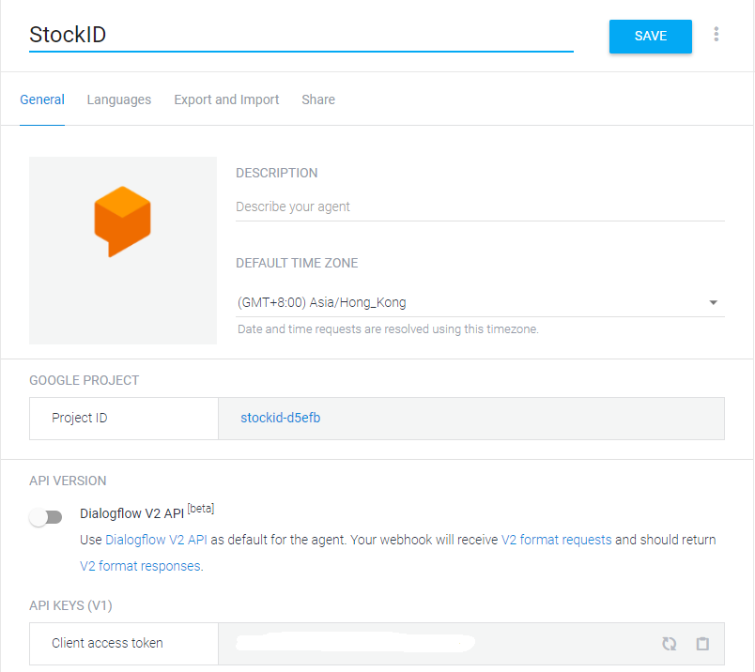
Api ai
Client access token

Slide 40
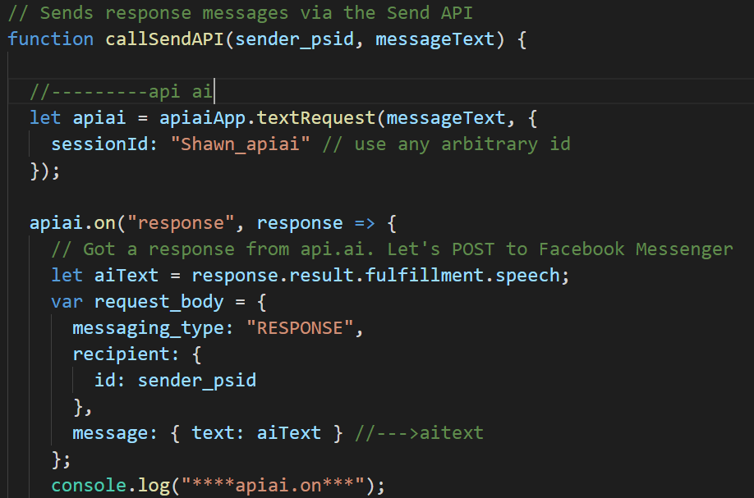
Api ai
var apiaiApp = require('apiai')(CLIENT_ACCESS_TOKEN);

Slide 41
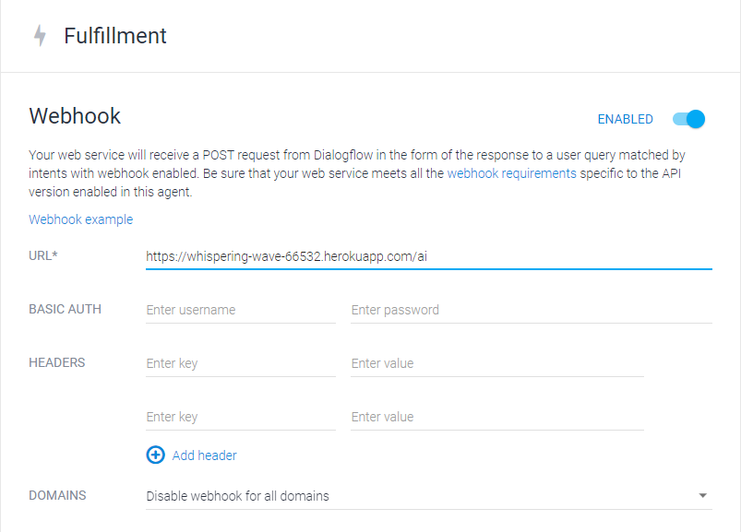
Api ai

Slide 42
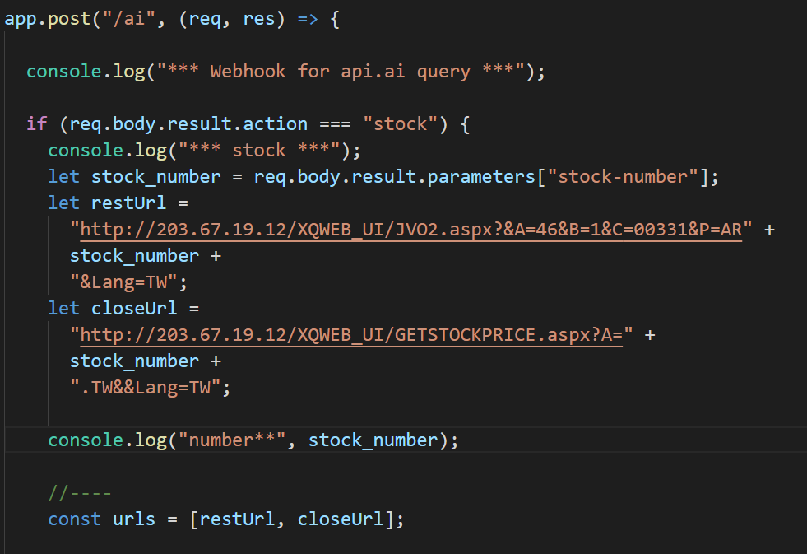
Api ai

Slide 43
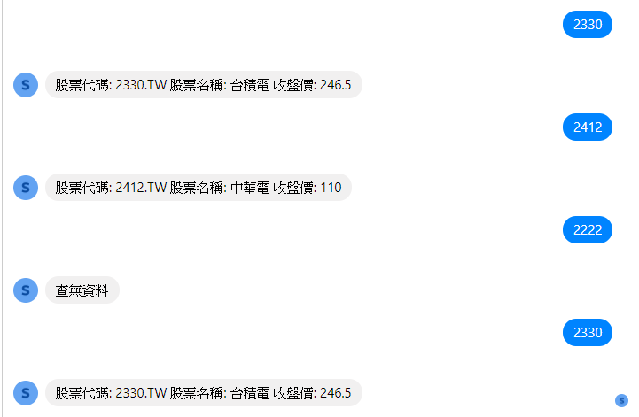
Demo

Slide 44
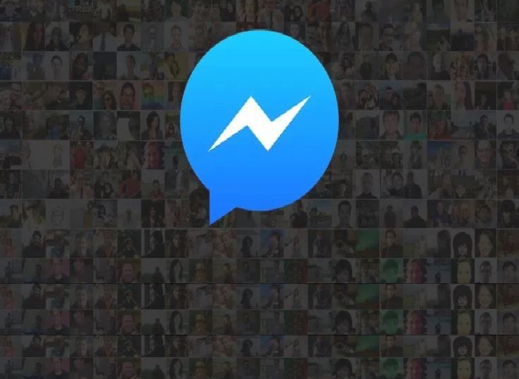
Thank You!

